Slide 1
COP29
LWVUS Observer Notes: Week 2
Necia Quast

Slide 2
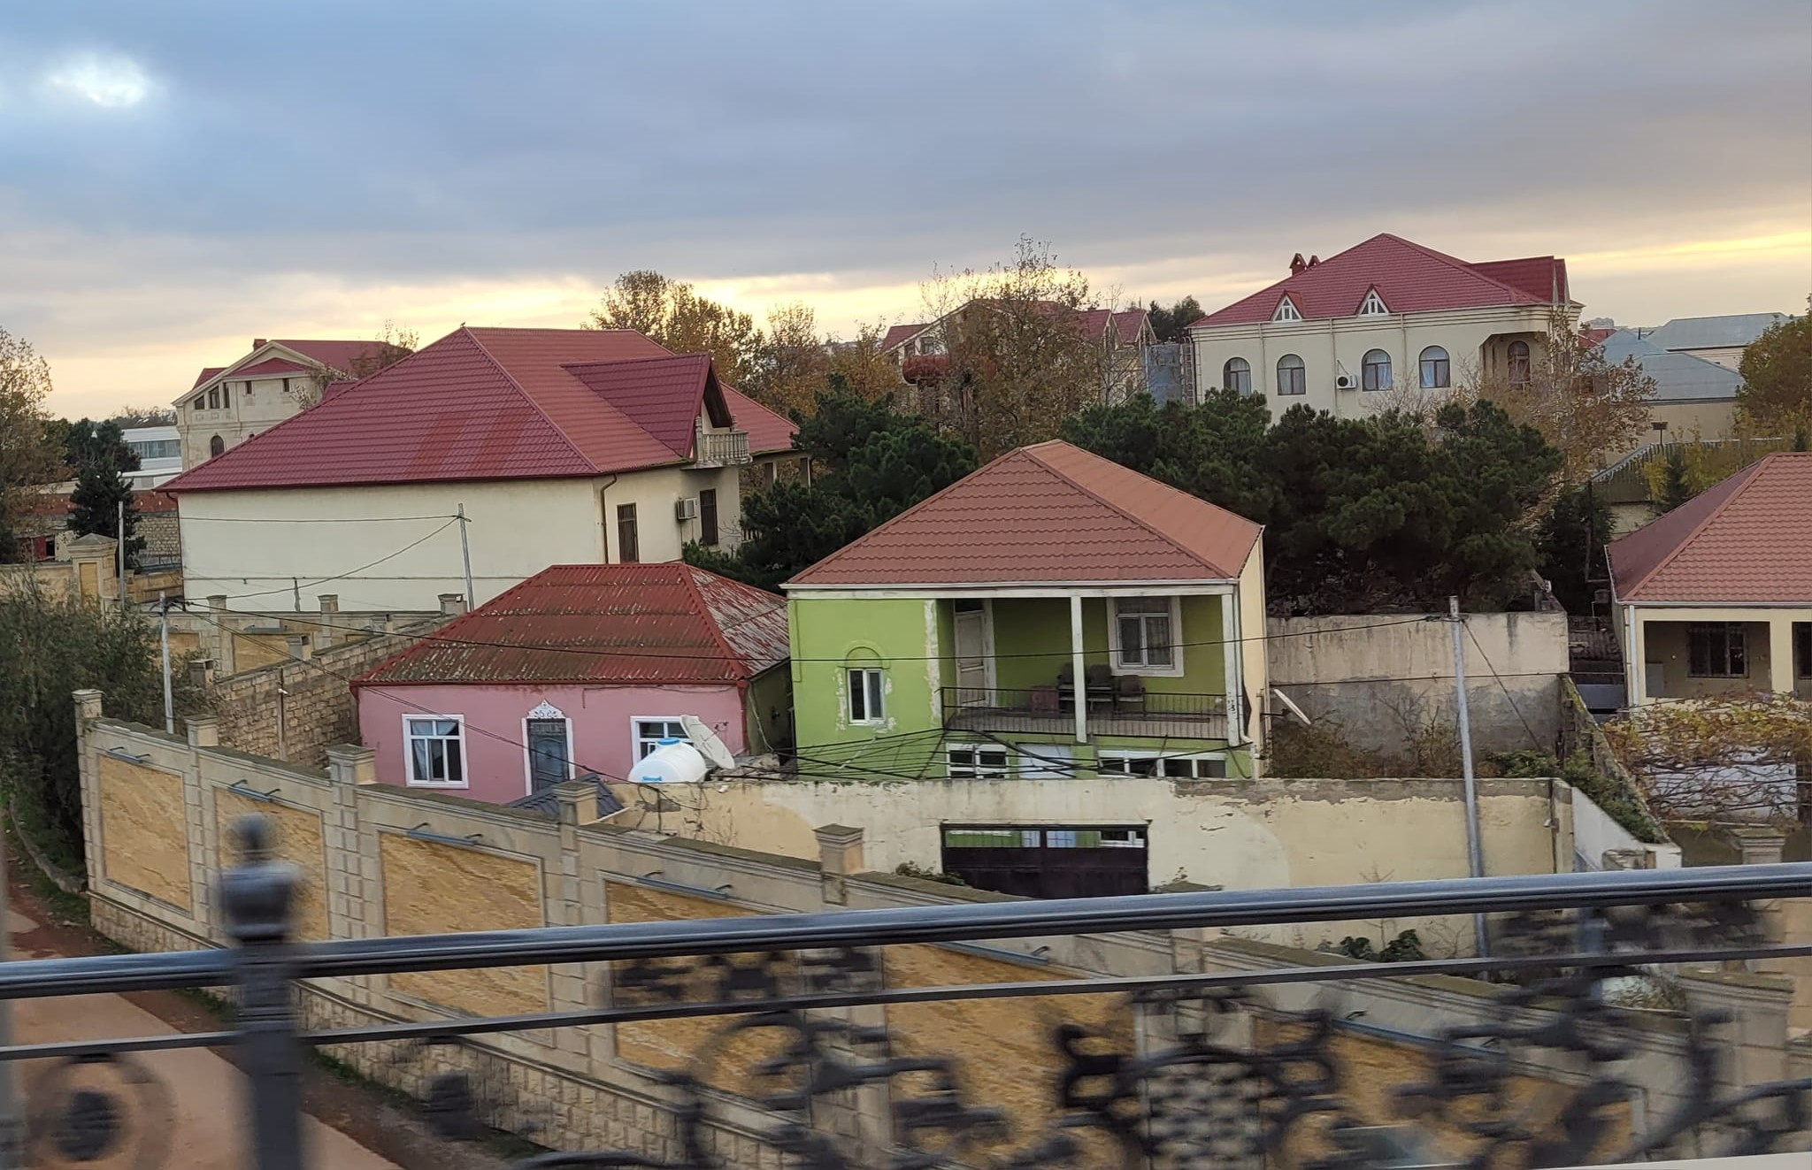
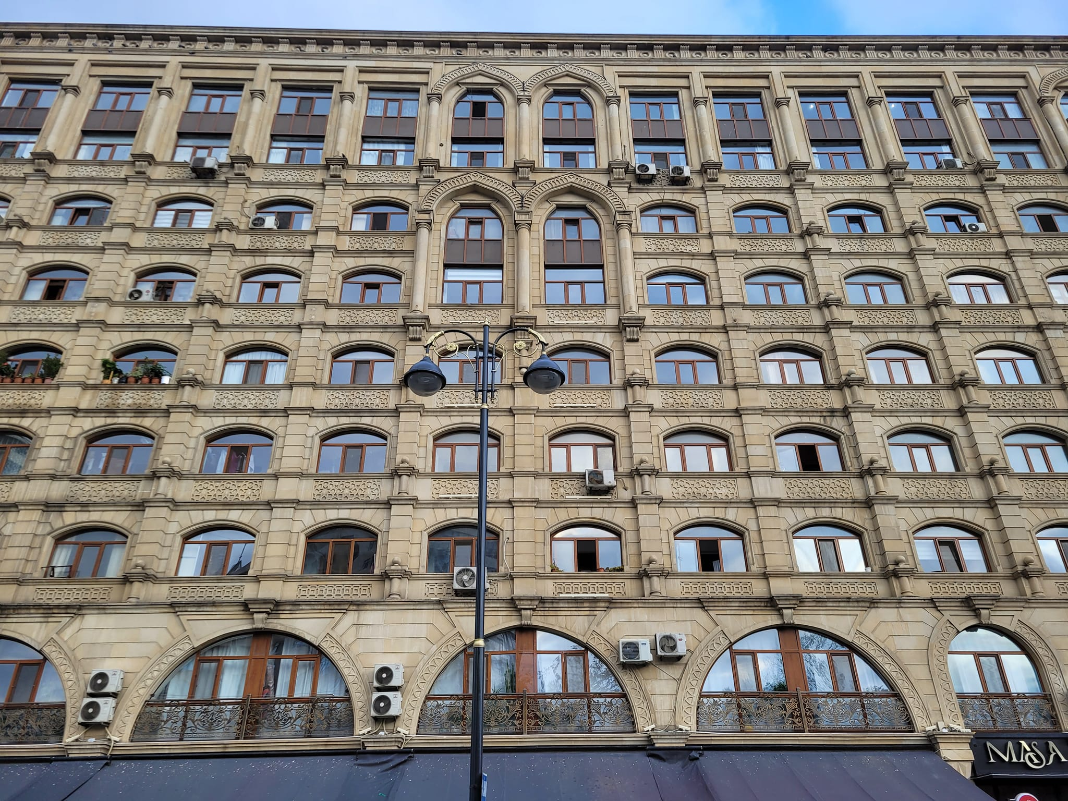
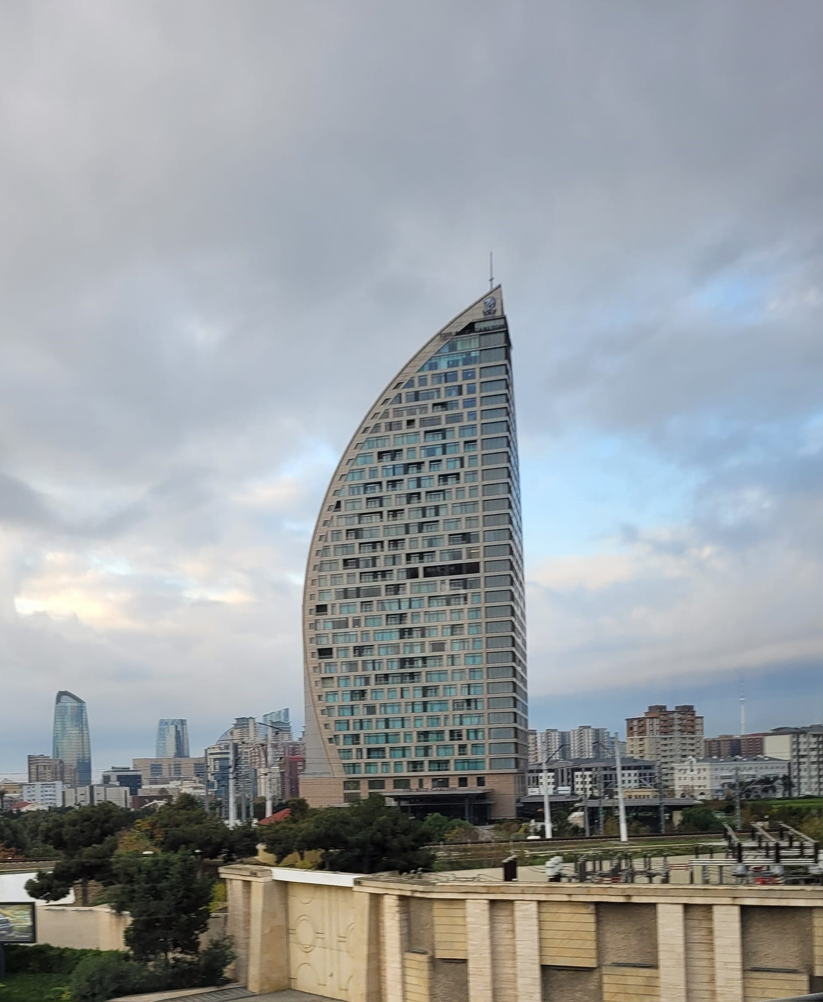
COP29 Baku, Azerbaijan November 11-22

Slide 3
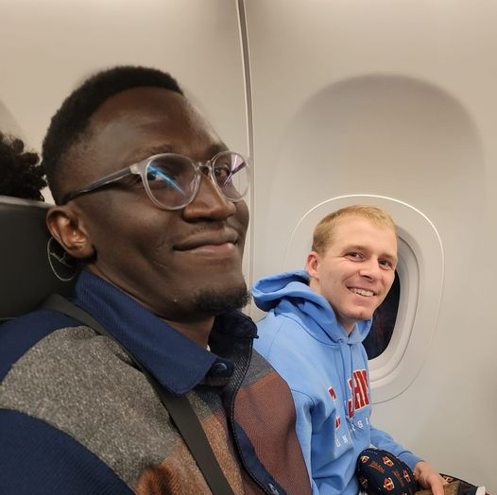
November 17, 2024 4:30 AM
I am in Baku Azerbaijan attending the second week of the annual climate change COP meeting for the League of Women Voters US. On the flight here, I had some interesting conversation with my seatmates also coming for COP29.
Dennis is a doctor from Kenya who works at refugee camp of mainly people from Sudan. He is here representing International Physicians for Preventing Nuclear Weapons. We talked about getting military activities included in emissions inventories and about gender violence. They have some successful programs using sports to reduce gender violence in their refugee camps.
Brandon is a student from St. John's University in Minnesota and doing research on improving climate resilience in agriculture.
I spent today catching up on sleep and getting oriented to get myself to the conference venue tomorrow.

Slide 4
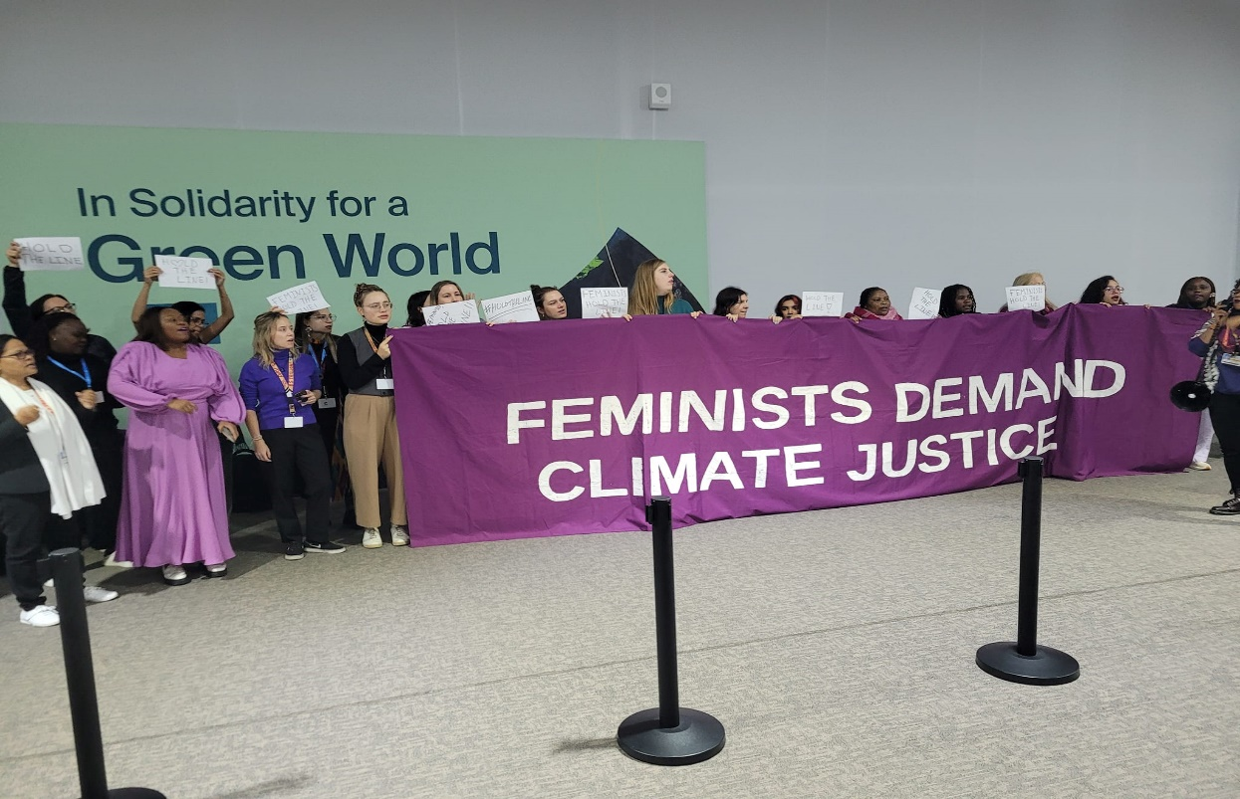
November 18: COP29 Day 1 First Dispatch.
Got my credentials just in time to catch this demonstration from women protesting proposals to remove language about human rights and gender issues from climate agreements.

Slide 5
COP29 Day 1 Dispatch 2
Attended a talk about NASA's Globe program: www.globe.gov Which allows students and others from around the world to take local measurements and add them into a database tracking conditions.

Slide 6
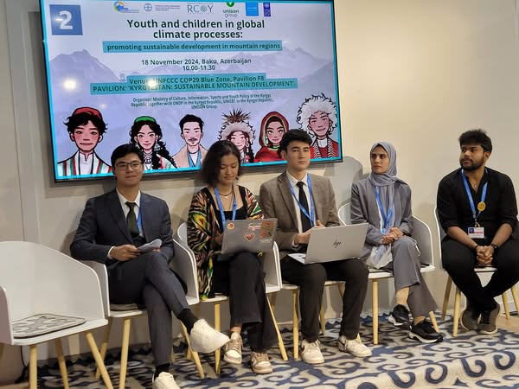
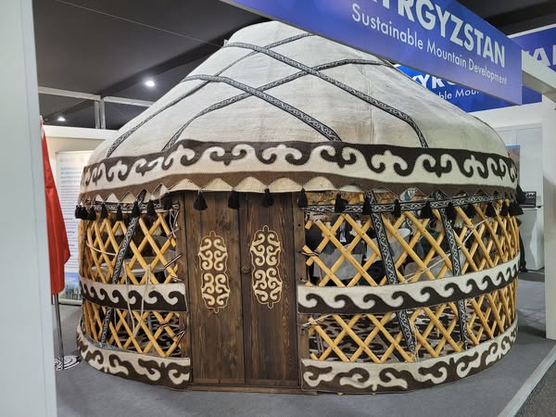
COP29 Day One Dispatch 3
The theme for today is Youth, with a wealth of events to choose from. Having lived in Kyrgyzstan and Tajikistan, I decided to take in one on Youth Engagement in Central Asia hosted at the Kyrgyz Pavillion. A lot of focus was on the challenges of mountain regions, experiencing erosion, floods, water shortages and loss of biodiversity, and most worrying, the loss of glaciers that provide fresh water and hydro-electricity.
They talked about despite the many references to the importance of Youth in UN climate documents, this is mostly symbolic, with Youth having no real role in decision- making. Echoing points at the morning demonstration, they also emphasized the importance of women and human rights in meeting climate goals.

Slide 7
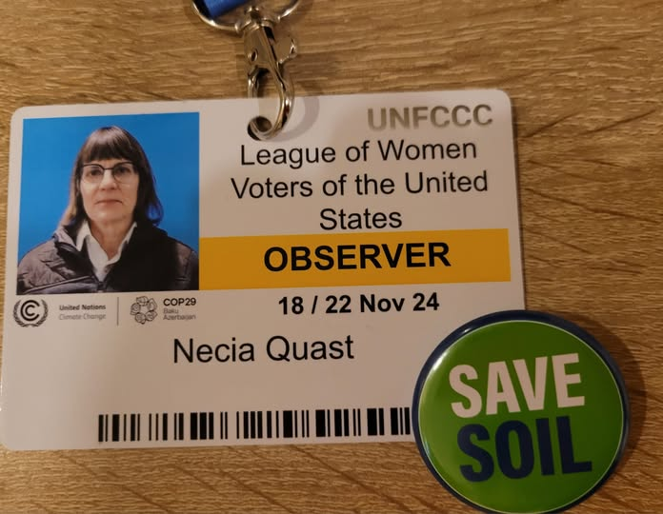
COP29 Day 1 Dispatch 4
I picked up this Save Soil button, and it was the theme of the afternoon as I checked out three Agriculture panels, on livestock issues, on climate solutions for small holders, and on food systems in Bangladesh. All mentioned protecting soil.
Though climate impact on agriculture and food security is already high with droughts, fire, extreme heat, and floods increasing in frequency and severity, less than 4% of climate funding goes to agricultural and most of that is spent in developed countries, with only a fraction going to the smallholders who are among the most threatened, most of them women.
Already many crops can't be grown in traditional areas. And did you know that higher levels of carbon in the air can reduce the nutrition in plants? Still genetic research is producing higher yield drought resistant varieties. Asia is switching to dry seeding rice which produces two crops, uses less water, and lower emissions. They are also producing nitrogen fixing versions of maize, wheat and rice that are self-fertilizing.

Slide 8
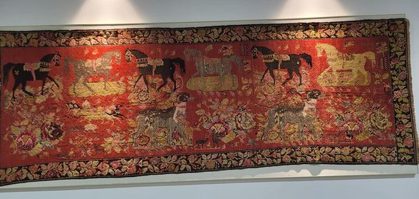
November 19: COP29 Day 2, Dispatch 0
Starting the day with some gorgeous Azerbaijani rugs and this key point from yesterday's agricultural sessions. Access to family planning services is vital to the productive capacity of women farmers and their ability to produce enough food to support their families.

Slide 9
COP29 Day 2, Dispatch 00
The press center goes on and on. Observing some press conferences this morning.

Slide 10
COP29 Day 2, Dispatch 1 The Empire Strikes Back
If yesterday I was getting my bearings and taking in topics of personal interest, today I am looking at the big picture of what is happening in the negotiations, and it is not pretty.
Yesterday I did mention efforts to strip human rights language and women's needs from agreements. In fact, petrostates, patriarchy and corporate interests seem to be carrying the day in obstructing stronger action.
You may not know Azerbaijan is a major oil producer. It has used its COP presidency to do things like block reform of carbon trading rules that are easily gamed by emitters. Along with Russia, Saudi Arabia, Egypt, and Vatican, they have blocked commitment to gender equality.
And new commitments on mitigation (reducing global warming) and adaptation (actions to cope with a hotter world) are also struggling. Most financial resources are directed to the private sector vs. public and non-profit sectors as corporate lobbyists are succeeding in shaping action.

Slide 11
COP29 Day 2 Dispatch 2
I went to three press conferences in which US environmental NGOs expressed fears and frustrations about future U.S. policy; US Ag Secretary Vilsack noted some progress and optimism; and African countries expressed frustration with Climate Finance.
Noting that 2024 would be the hottest year yet, American activists said the US was seeing serious climate impacts that could only be addressed with global action. They called on Biden to lean forward at the COP.
Secretary Vilsack said there was strong bipartisan support for programs that address mitigation and adaption in agriculture; that farmers are taking up these programs in rapidly growing numbers and would advocate for them, and funding is secure for several years.
Meanwhile, African countries noted that their continent had not created the problem or reaped the benefits of carbon emissions, while suffering severely from the negative impacts. With most help offered in the form of loans to already highly indebted governments, or private sector funding they could not access, climate justice remains out of reach.

Slide 12
COP29 Day 2 Dispatch 3
The Executive Secretary did a session today specifically with Observers. They have doubled the number of accredited observer organizations since the last several COPs, adding many from the global south, which is why there are fewer badges for each group.
He briefed us on the negotiations so far, as they move from technical talks last week to political negotiation, with ministers coming in. Several things were not agreed in during technical discussions and Azerbaijan in its role as presidency has appointed teams to lead the political efforts to reach agreement, including on mitigation and on gender which has become a battleground, as noted earlier.
He took questions from the floor. The environmental NGOs raised the high number of fuel industry lobbyists present at 1800. He said this was determined by the parties (countries) but that the Secretariat took a stand about making that number publicly available as a matter of transparency.

Slide 13
COP29 Day 2 Dispatch 4
Quakers are UN Observers and have offices in New York and Geneva, and I expected they would present here and as a Quaker myself hoped to touch base, but how to track them down among the 50k+ attendees?
When I saw the World Council of Churches was holding a press conference, I attended and sure enough a QUNO rep was on the panel. The panel members emphasized that stewardship of the earth, taking care of the vulnerable and living in peace are core religious values, and they hoped to remind the powerful of those not in the room.
They decried growing nationalism, the climate impact of the wars and bombings, and irony that countries spent trillions on military defense while underfunded efforts to deal with global warming that threatens all humanity. What would really keep us safer? they asked.

Slide 14
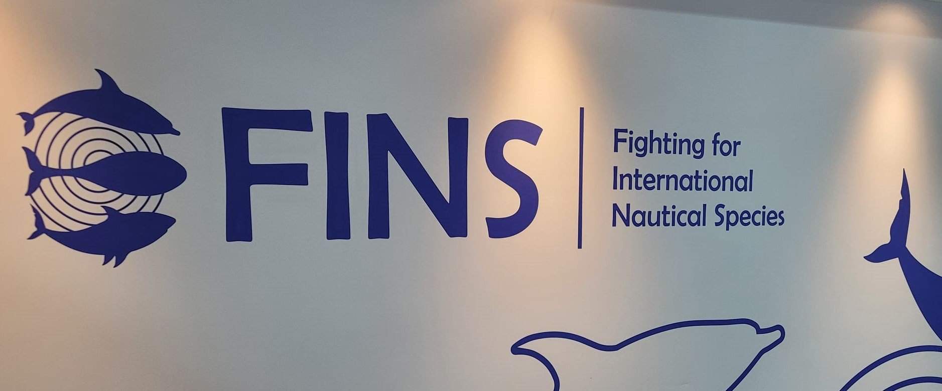
COP29 Day 2 Dispatch 5
To end my day, I went to visit the Green Pavillion. Until then I have been at the Blue Pavillion where the negotiations take place. The Green Pavillion hosts company stands, NGOs, universities and others who don't get Blue Zone space.
Here it was mostly companies and mostly from Azerbaijan, but there was some interesting stuff nonetheless. Pictured below is the giant impressive model of Baku White City. A section of town that was a waterfront industrial district so polluted it was known as Baku Black City was cleaned up and completely redeveloped.
Also pictured below is FINS, one of the few NGOs present, that is focused on protecting marine life. When I wandered by International Trade House, my economist nerd side got sucked in by a panel on agricultural trade.

Slide 15
November 19: COP29 Day 3, Dispatch 1
So first up this morning, I attended a panel at the US pavilion on improving resilience to natural disasters, where one of the panelist was a state senator from Washington. He spoke about the early warning system for wildfire the state has implemented with satellite surveillance that immediately notifies fire response when smoke is sighted allowing early response by air.
In the sidelines of that I met someone from the Georgetown Center on Climate who is an expert on energy focused on mitigation who shared her concern about the rapid shift in attention from mitigation to adaptation. In fact, the NOAA rep on the panel had just said "Of course, we must continue to do mitigation, but with impacts we are now seeing we need to increase adaptation." The powerful interests obstructing mitigation efforts makes adaptation the path of least resistance.

Slide 16
COP29 Day 3 Dispatch 2
A few sobering facts from a high-level discussion of Green Construction and Energy. Buildings, 2/3s of which are residential are responsible for a significant chunk of global emissions. These emissions are not increasing, though the equivalent of a Paris is built each week, neither are they falling.
To limit the rise of global temperatures to 1.5% we need to cut emissions (mitigation) by 40% by 2030. In 2023 emissions grew 1.3%. To hit the target emissions from buildings need to start falling now.

Slide 17
COP29 Day 3 Dispatch 3
It is no secret that severe heat has an impact on health, with heat-related deaths soaring in recent years as each succeeding year takes up the crown of hottest on record. Experts from Canada, the US, Nigeria the WHO European division, addressed the impact and steps countries and communities can take to protect people from high heat, often in places more focused on protecting people from severe cold.
Death rates and factors vary widely from place to place making it important both to have finely grained local information and responses. The most vulnerable also vary from place to place. In cool/temperate climes the elderly without air conditioning die in their homes. In more desert and tropical/climes, the homeless, and those with addictions and mental health issues die outdoors. Suicide rates go up with temperatures.
Outdoor workers are highly vulnerable and many places are focusing on providing standards and advice to protect those working outside in extreme heat including agriculture and construction workers.
The picture is not from Baku, but on the U.S Canada border where last year a heat dome killed over 600 people in British Columbia alone.

Slide 18
COP29 Day 3 Dispatch 4
The Energy and Environmental Study Institute, a US based think-tank keeping the US Congress up to date on climate science released a study demonstrating that US agriculture could become greenhouse gas negative through reduced emissions and increased carbon capture. The representative of Farmers and Ranchers in Action with 700k members said farmers are rapidly taking up conservation and climate measures and that agriculture was shifting from being considered a problem to being seen as a solution.
The International Alliance to combat ocean acidification, started by California, Washington and Oregon, now has 15 states and 18 countries as members. The oceans absorb up to 40% of carbon emissions which is driving acidification and impacting shorelines, fishing and marine life.
Whatever the national government does in the US, states representing over half the US population remain committed to climate action. This press conference echoed what I heard elsewhere today: in general sub-national actors-- states, cities, businesses, and communities--often have more ambitious targets than national actors. Programs established by the Biden administration have a lot of momentum and already committed funding that will have impact. This includes programs with China, which also has joint climate projects with California.
As for COP29, its job is to raise finance commitments, and the amounts, structure, and scope still remains unclear. Mitigation will remain an open question as new commitments are not due until February.

Slide 19
COP29 Day 3 Dispatch 5
Rounded out the day with another set of panels on cities and dipped into a panel on forests. Cities are responsible for 70% of global emissions but produce 80% of world GDP. Cities are expected to add 5.2 billion people by 2050 and hold 75% of the world's population. Currently 25% of the world's pop. lives in slums and informal settlements. Making those informal settlements part of served cities is key both to reducing emissions and improving the lives of those who live there. Adding trees and cooling are key to the survival of city dwellers.
Nearly 11k cities have their own climate plans and commitments, and more than 800 have committed to becoming Net Zero. 75% of are reducing emissions faster than national commitments.
Lagos is a leader in helping educate its population on how to cope safely with extreme heat including drinking more water, cross ventilating, and staying in shaded areas when outdoors. Dubai is leading in lower cost ways to cool buildings and sharing the technology with other parts of Asia. Looking forward cooling and AI are expected to be the largest drivers of growing electricity demand, so improved cooling is key.

Slide 20
November 21: COP 29 Day 4, Dispatch 1
In the main pavilion area things are clearly winding down, with many Pavillion opening late or closed down entirely. The program at the Singapore Pavillion is starting 35+ minutes late, so I will probably leave early to catch a Sea Ice panel at the Canadian Pavillion.

Slide 21
COP29 Day 4 Dispatch 2
Cities and systems need to move from conventional to green (in process now) to sustainable, to restorative to regenerative. In Europe 81% of ecosystem habitats are in poor condition. Soils are degraded. A new law on nature restoration requires protecting and increasing city green spaces and canopy cover. Solutions have multiple benefits and make cities work better. For businesses, the top four risks are climate-related so they have an incentive to make climate friendly decisions.
Sea ice is disappearing rapidly; one of several climate systems nearing a tipping point. With the current warming trajectory arctic sea ice will not survive. The Arctic is warming 3 to 5 times faster than the rest of the planet. Sea ice reflects solar radiation so its loss will lead to faster heating. More concerning is the possible loss of a key Atlantic current which is slowing; its collapse would have devastating impacts on the climate, fish, food security and economies.
There are potential ways to preserve and thicken sea ice including increasing cloud cover to boost solar radiation, and the more radical ideal of aerosol injections, but feedback loops, negative side effects and possible unintended consequences are not well understood as the knowledge gaps are large. However, the urgency of sea ice loss is leading some to demand to deploy solutions whose impacts are not well understood.

Slide 22
COP29 Day 4 Dispatch 3
People and activity picked up as the day went on, but my planned schedule was pretty frustrating. The late start of the Singapore panel meant I had to leave early for Sea Ice. Two events I wanted to go to turned out to be cancelled, one had no more room, one had apparently started early, and ended ten minutes after I arrived, another was in Portuguese with no translation, and two turned out to be on different topics.
The one afternoon event on time and as advertised was an interfaith press conference calling on national leaders to take more aggressive action. I was one of only five people there to hear it. They called on all religious institutions, which own 120 million houses of worship and additional real estate, hospitals, schools and investments, to make their own property sustainable; to be examples in their communities; to divest from fossil fuels. They acknowledged that there remain disagreements on these issues among faith communities.

Slide 23
COP29 Day 4 Dispatch 4
I caught the end of a talk on how U.S. universities in North Carolina are supporting Ukraine in rebuilding and listing the environmental damage down by Russian bombing including the destruction of a hydro power damn that is worsening environmental damage and increasing emissions from Ukraine.
A talk I expected to be on climate science was actually about the impact of climate change on mental health. Those experiencing weather disasters, extreme heat, and lost livelihoods are suffering grief, depression and anxiety. Young people in particular are experiencing anxiety, and often despair, as each year breaks heat records, disasters increase in number and severity, far from falling, emissions continue to rise.
Youth also experience frustration when people say young people must lead in solving the problem because a) they did not cause it and b) they have no real power or influence in decision making.

Slide 24
November 22: COP29 Day 5 Dispatch 1
On what was scheduled to be the last day of COP29 things were pretty quiet, with most pavilions closed. The mood was somber as negotiations had accomplished little. Discussions of many issues had stalled and been kicked down the road, and the main goal of defining and committing Climate Finance amount, structure and priorities had two blocks of countries far apart. With no numbers or areas of agreement. A final draft of the proposed text was due at noon.
The main activity was press conferences. These expressed frustration; most cited the dire situation, two years now recording heat levels above the 1.5 degree target, and key tipping points approaching.
The final draft text eventually was issued at 3pm with a proposed $250 billion annual commitment, more than what has been currently provided but well short of estimated needs.The negotiations were extended to Saturday as they seek consensus on a final text.

Slide 25
COP29 Day 5 Dispatch 2
I mentioned some of these things before. but I will list together a few key facts.
To meet the Paris target of limiting the average global temperature rise to 1.5C degrees we need to cut emissions by 40% by 2030. Last year's emissions increased. Last year our carbon sinks collapsed--there was no net removal of carbon via forests, fields and oceans.
Each of the last few years has set a new annual average temperature, and 2024 is on track to be the highest yet. Last year was already above the 1.5 level (although this does not mean the global average is, as that looks at multiple years).
The Arctic ocean is now ice free four months of the year so ice does not reflect heat back out in that period, contributing to the Arctic warming 3 to 5 times faster than the rest of the globe. This feeds back into overall temperature rise and glacier and icesheet loss, sea level rise and permafrost releasing more emissions (see collapse of carbon sinks above.) A key Atlantic current that moderates European temperatures is becoming unstable. If it stops, then more dramatic climate changes will ensue.
If we don't hold the 1.5 degree target but go to a 2 degree rise, there will be a complete loss of Arctic ice, loss of all tropical and mid- level glaciers, and 70% of current food crops will be non-viable where they are now grown.
The photo shows the outlook going forward several hundred years. With "business as usual" global temperatures will be about 3 degrees higher by 2100 and 6 or more in following centuries If we completely eliminate carbon emissions we can hold it to 2.5 in 2100 and 4 down the line. If we remove existing carbon in the atmosphere, which will take time, we can eventually get back to current or lower temperatures, but not until a couple hundred years out. In the interim period it might be possible to use solar reflection to keep us below 2 degrees.

Slide 26
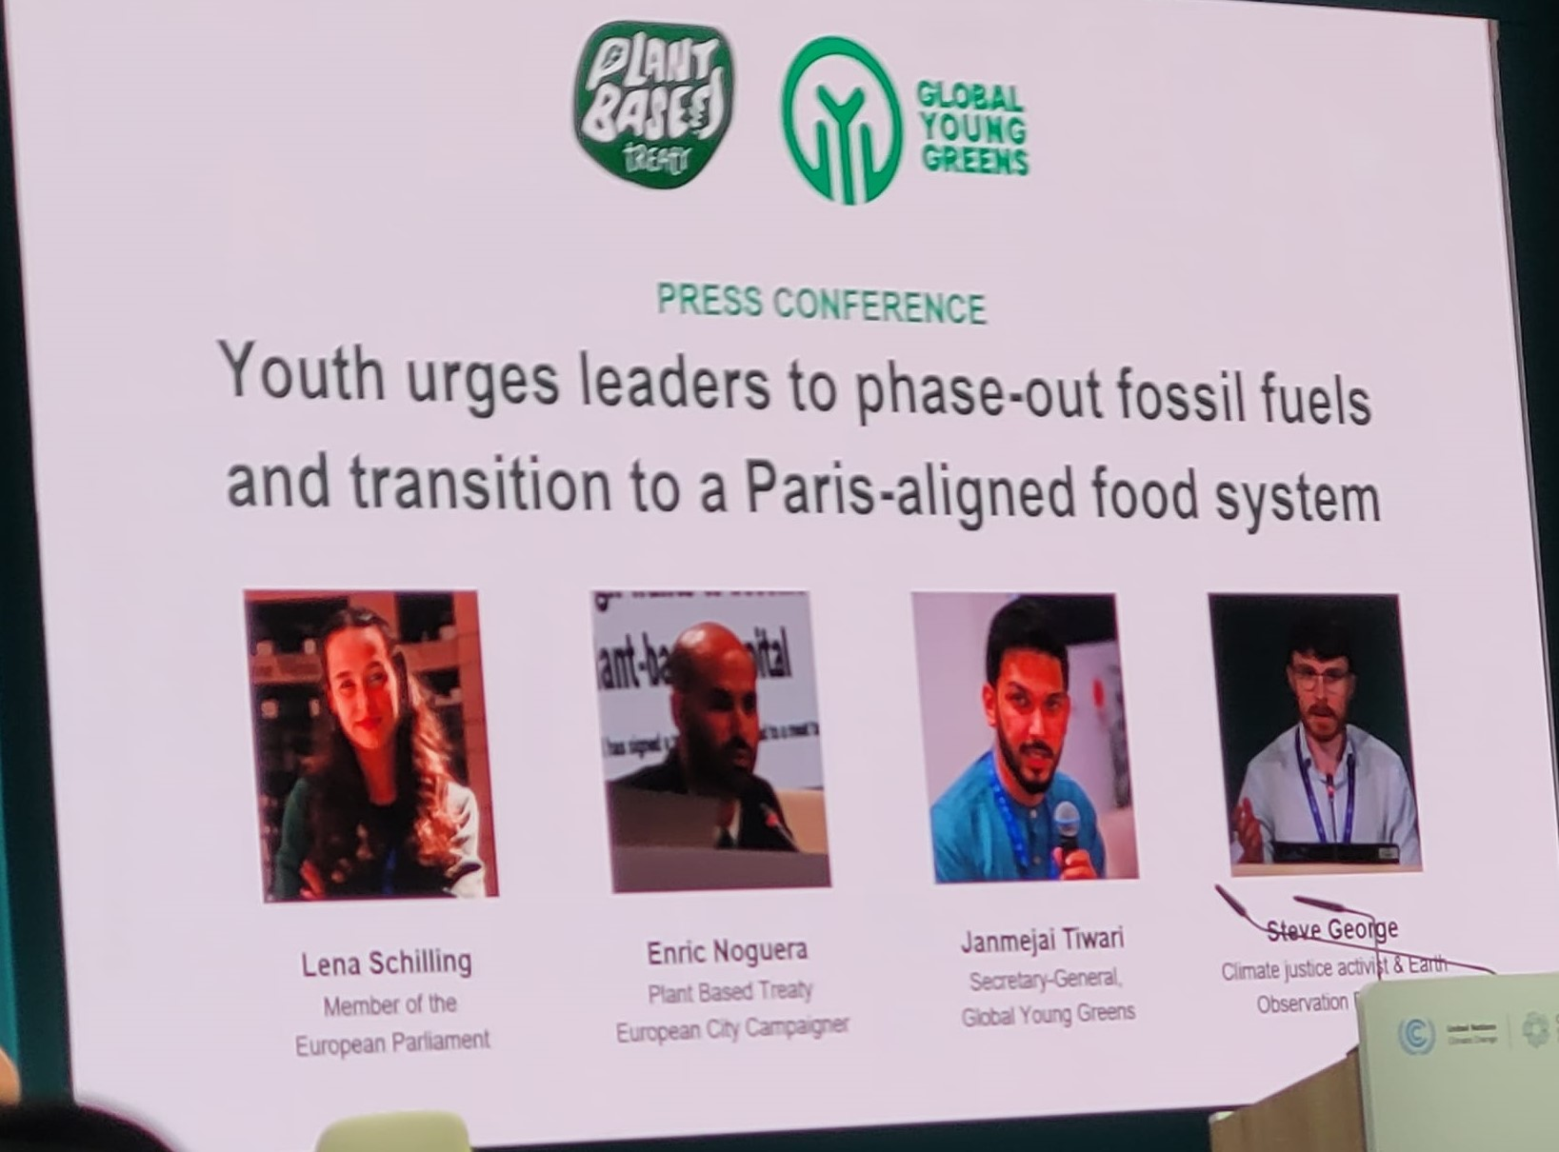
COP29 Day 5 Dispatch 3
Well, I am home, but negotiations continue back in Baku with the "number" from developed countries raised to $300 billion.
Meanwhile yesterday, I attended a panel discussion by a group of youth who at the beginning of the event discussed their hopes and yesterday were discussing their feelings about how things went. These kids were very smart and knew their stuff. There also was a press conference by youth organizations with their statement about lack of progress on key issues.
Like everyone they were disappointed about how this and recent COPs have gone. Especially now that developed countries are seeing serious impacts from climate change, they had hoped and even expected that negotiations would become more productive.
Although there are now more opportunities for youth voices to be heard at negotiations, it is still more window dressing than having an impact on negotiations. The common statement that "young people will fix this" feels to them like an abdication of responsibility from those who have created the problem and failed to make more progress in the last 30 years. It ignores the fact that youth are not in the positions of power to affect many of the key decisions.

Slide 27
COP29 Day 5 Dispatch 4
On my final day at COP29, everyone was waiting for the final draft text, due at noon, It eventually showed up at 3:00 pm and the COP was extended and finally closed late Saturday night. But on Friday the frustration was palpable. Groups were doing what they had expected to be their wrap-up press conferences, but it was unclear if there would be any progress at all. As one person put it, rather than trying to push forward goals, they were either retreating or defending against retreats. Another person said much of the negotiations were spent just re-arguing about what was agreed to in past years.
The last three COPs were hosted by petro-states--Egypt, then the United Arab Emirates, and this time Azerbaijan. In some cases, the heads of national petroleum companies were part of or even leading country delegations. Over 1800 fossil fuel lobbyists were present, and the UN climate agency said it was victory on their part just to insist that that information be made public. I was told that Saudi Arabia used both assistance and preferential oil trading to pressure countries to fall into line. Likewise the fights over human rights and keeping a commitment to supporting women farmers have become annual battles.
Meanwhile, warming and its impacts are accelerating leading many to feel like the opportunity to avoid truly epic disasters is receding ever faster. Next year's COP will be in Brazil. It will be interesting.

Slide 28
COP 29 Final Dispatch -Wrap Up
I went to COP29 with a basic understanding of climate issues but by no means an expert. I return better informed, but still no expert. The situation is serious and we still are doing too little, too late to avoid very serious impacts from global warming. They are already happening and accelerating.
COP29 increased commitments to Climate Finance which was its main goal, but the $300 billion annually, though up, falls well short of the estimated $1 trillion annually it would cost to finance the needed actions. Collectively government subsidies to fossil fuel industries amount to that. Defense budgets exceed that many times, even though global warming is the biggest threat to human life and stability we face.
The climate agreements and annual meetings have three main goals, rotate as the focus. 1) Mitigation, which is addressing the cause and seeking to reduce carbon 2) Adaptation, changing how we things to cope with the new reality. 3) Finance: who pays and how. All three need to move together, because time is short, but at COP29 negotiations about mitigation and adaptation were tabled for later. Obstruction from the politically power fossil fuel interests has kept progress minimal in recent years. Some people worry that there is tendency to reduce attention on mitigation and focus adaptation, since stuff is getting real. What it ignores is that without mitigation, adaptation will be much harder, less effective, and more expensive.
Another worry was about the incoming administration, as last time Trump pulled the U.S. out of the Paris Agreement. In general , as everyone has been through this before, it was more background buzz than a central element. Many U.S. states, cities and companies formed a group called "We're Still In" in which they pledged to continue forward on their own climate commitments. Since a lot of actions are implemented at local levels this means progress continues. More and more U.S. farmers, who are often the first to experience ongoing impacts, are also becoming keenly interested in both mitigation and adaption measures.
There is a lot of research and cool technology out there, which is exciting and will help with adaptation and possibly mitigation, but there is general agreement that we cannot engineer our way out of the most serious impacts of global warming. It will need collective human action on a scale that we seem hard pressed to achieve.

